Slide 1

Family Asset Protection Planning
PLAN ASSEMBLY

Slide 2
PRELIMINARY Plan BENEFITS
Takes the pressure off: Allows you time to think through the plan based on available strategies
If your fees vary by complexity, you will better know how to charge
Fees are graduated
Putting “pen to paper” facilitates sequential thinking
You can format the initial plan as a letter OR you can format it as an outline just for yourself and to guide the meeting
You can present orally, on paper and/or on screen
You obtain more information in development of the final plan

Slide 3
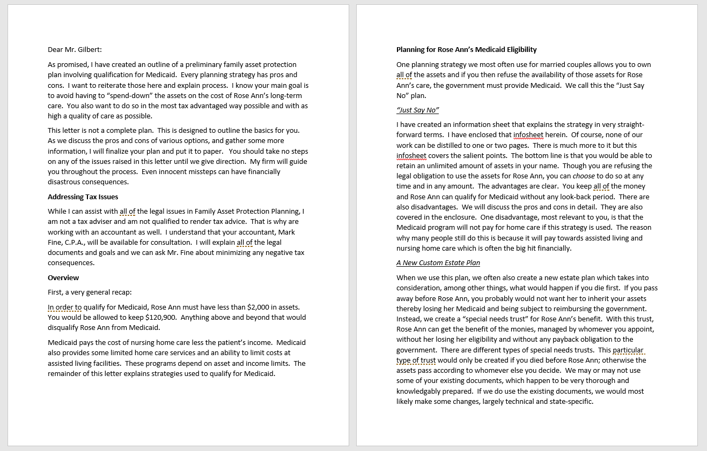
Letter formAT

Slide 4
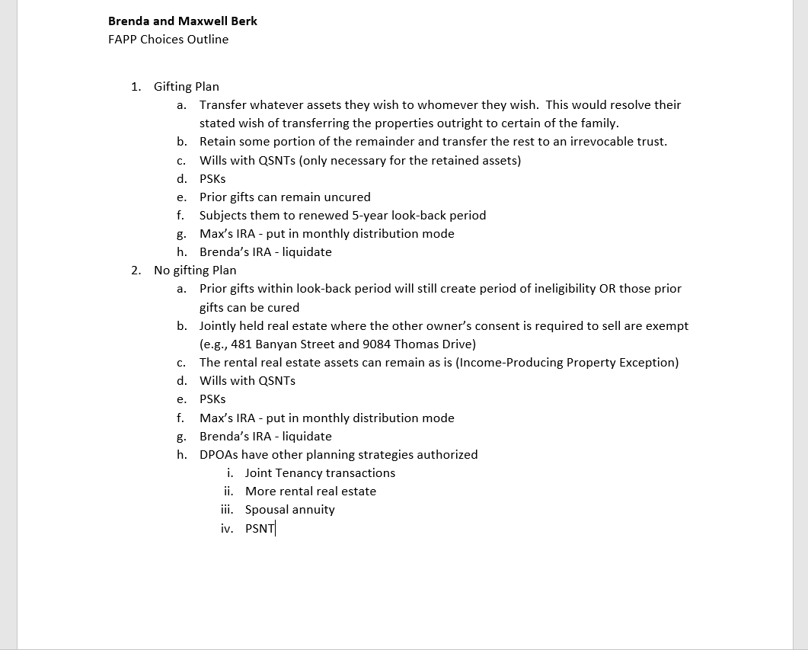
Outline Format

Slide 5
Presentation to client
Present and discuss the Initial Plan at the follow-up meeting
  Always include the “Doing Nothing” option
  Avoid too much detail (explain that will come in an orderly and understandable fashion)
  Explain your implementation process
After showing value, quote fee if not already explained
Get fully retained

Slide 6
Purpose of plan letter
Difference between Plan Outline and Full Solution/Planning Letter
Explains the overall plan
Details each strategy and document
  Pros and cons disclosed, caveats and disclosures
  Benefits of uniform language
  Confirms essential facts
  Client has a concrete “deliverable”
Serves as internal guide
Can be updated

Slide 7
Plan letter Assembly
Use Stem Plan Letter
  Uniform language
  Customized sections
  Refers to uniform “infosheets”
Determine which infosheets
Can have staff prepare initial version for your completion
Can copy to client’s chosen VIPs

Slide 8
